Slide 1
Sentence Parsing
Seung Jun Moon
삼성 DS-KAIST AI Expert 프로그램

Slide 2

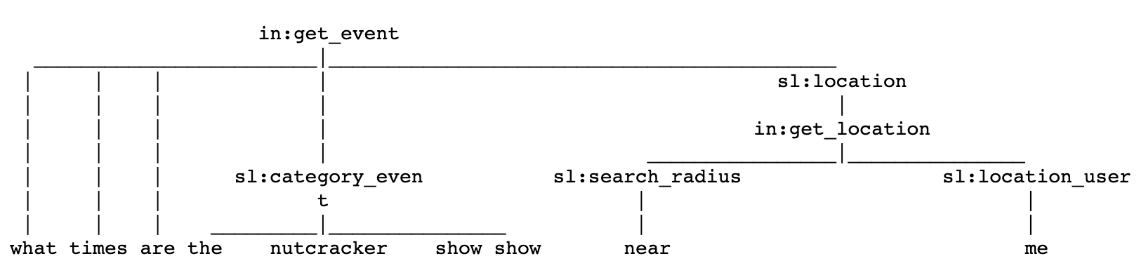
Sentence Parsing
Goal of this lecture is …

Slide 3
Table of Contents
Preprocessing
Sentence Parsing with LSTM seq2seq
Sentence Parsing with Transformer

Slide 4
Table of Contents
Preprocessing
Sentence Parsing with LSTM seq2seq
Sentence Parsing with Transformer

Slide 5



Preprocessing
Dataset is consist of rows of
Raw Sentence
Tokenized Sentence
Parsed Sentence

Slide 6
Preprocessing
Load a Pretrained word embedding vector.
glove.840B.300d.txt contains 300-dimensional vectors of words.
Let’s save it into a numpy array file ‘word.npy’.

Slide 7
Table of Contents
Preprocessing
Sentence Parsing with LSTM seq2seq
Sentence Parsing with Transformer

Slide 8
Sentence Parsing with LSTM seq2seq
Seq2seq Model
Pretrained with Glove

Slide 9
Sentence Parsing with LSTM seq2seq
Seq2seq Model for sentence parsing
Attention Layer
Pretrained with Glove

Slide 10
Sentence Parsing with LSTM seq2seq
Seq2seq Model for sentence parsing
Attention Mechanism

Slide 11
Table of Contents
Preprocessing
Sentence Parsing with LSTM seq2seq
Sentence Parsing with Transformer

Slide 12
Sentence Parsing with Transformer
Transformer Model for sentence parsing

Slide 13
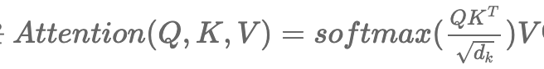
Sentence Parsing with Transformer
Self Attention of Transformer

